Slide 1
Chapter 2
Statistical foundations and dealing with data

Slide 2
The population and the sample
The population is the total collection of all objects to be studied.
The population may be either finite or infinite, while a sample is a selection of just some items from the population.
A population is finite if it contains a fixed number of elements.
In general, either all of the observations for the entire population will not be available, or they may be so many in number that it is infeasible to work with them, in which case a sample of data is taken for analysis.
The sample is usually random, and it should be representative of the population of interest.
A random sample is one in which each individual item in the population is equally likely to be drawn.

Slide 3
Probability and probability distributions - Some definitions
A random variable can take any value from a given set
A discrete random variable can take on only certain specific values (e.g., the sum of two dice thrown)
A probability is the likelihood of a particular event happening
A probability distribution function shows the outcomes that are possible from a random process and how likely each one is to occur
A continuous random variable can take any value (possibly only within a fixed range), probability density function (pdf) - probabilities associated with each range of outcomes
The probability that a continuous variable takes on a specific value is always zero, since the variable could be defined to any arbitrary degree of accuracy (0.1 vs 0.1000001 etc.) and thus we can only calculate the probability that the variable lies within a particular range.
There are many continuous distributions, including the uniform and the normal.

Slide 4
The normal distribution
The normal (Gaussian) distribution is the most commonly used
It has many desirable properties and is easy to work with
It is unimodal (has only one peak) and symmetric
The moments of a distribution describe its properties.
The first two moments of a distribution are its mean and variance
Only knowledge of the mean and variance are required to completely describe the distribution
A normal distribution = skewness of zero and
kurtosis of 3 (excess kurtosis of zero)
third and fourth moments of the distribution = Skewness and kurtosis (standardised)

Slide 5
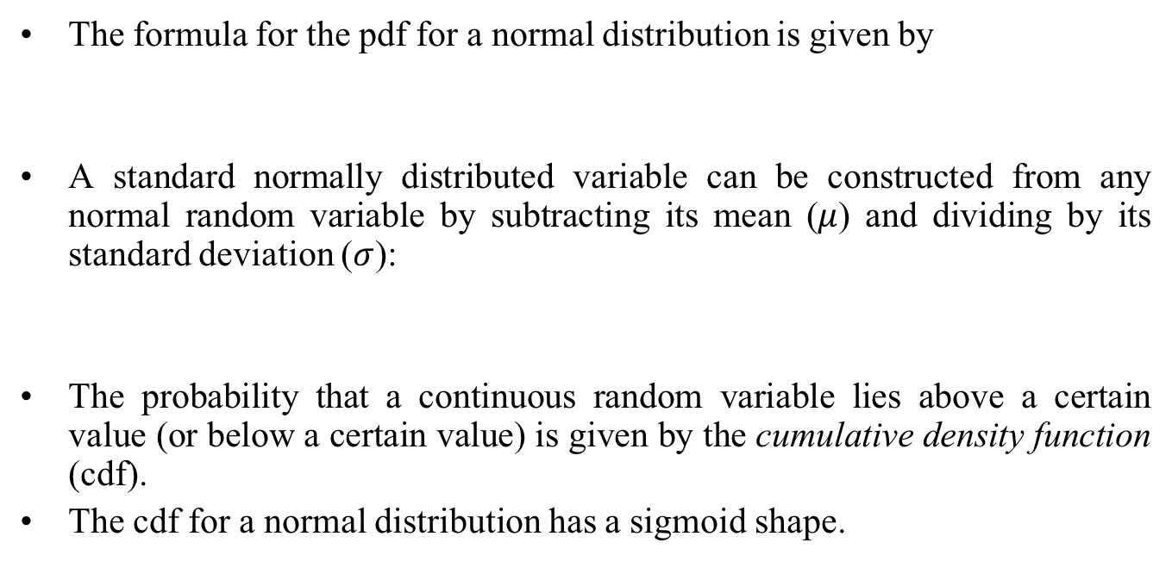

The normal distribution 2

Slide 6
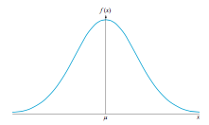
A plot of the pdf for a normal distribution
.

Slide 7
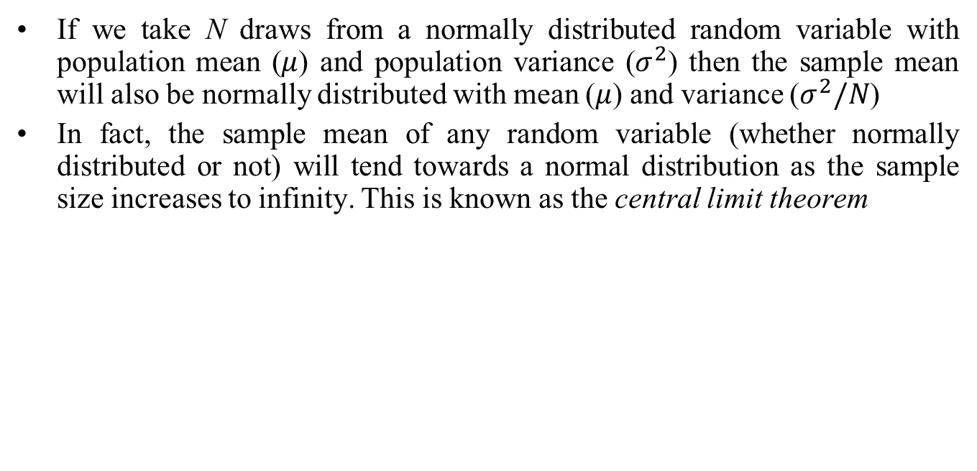
The central limit theorem

Slide 8
Other important distributions
Three other important continuous distributions are the chi-squared (𝜒²), the F and the t (sometimes known as Student’s t)
These distributions are all related to the normal and to each other
The sum of squares of n independent normal distributions will be a chi-squared distribution with n degrees of freedom
The ratio of two independent chi-squared distributions divided by their degrees of freedom n₁ and n₂ will be an F-distribution with n₁ and n₂ degrees of freedom
The t distribution tends to the normal as its degrees of freedom increase to infinity
Each of these distributions will be discussed in detail later at the point it is used.

Slide 9
Descriptive Statistics

Slide 10
Measures of central tendency
The average value of a series is its measure of location or measure of central tendency, capturing its ‘typical’ behaviour
There are three broad method to calculate the average value of a series: the mean, median and mode
The mean is the very familiar sum of all N observations divided by N
More strictly, this is known as the arithmetic mean
The mode is the most frequently occurring value in a set of observations
The median is the middle value in a series when the observations are arranged in ascending order
Each of the three methods of calculating an average has advantages and disadvantages

Slide 11
The geometric mean
The geometric mean involves calculating the Nth root of the product of the N observations
So the geometric mean of six numbers in a series would be obtained by multiplying them together and taking the sixth root
In finance, since the numbers in the series can be less than one, we use a slightly different method to calculate the geometric mean
Here we add one to each data point, then multiply together, take the Nth root and then subtract one at the end
where r₁, r₂ etc. are the data points that we wish to take the geometric mean of
The geometric mean will always be smaller than the arithmetic mean unless all of the data points are the same.

Slide 12
Measures of spread
The spread of a series about its mean value can be measured using the variance or standard deviation (which is the square root of the variance)
This quantity is an important measure of risk in finance
The std. scales with the data, whereas the variance scales with the square of the data. So, for §example, if the units of the data points are US dollars, the standard deviation will also be measured in dollars whereas the variance will be in dollars squared
Other measures of spread include the range (the difference between the largest and smallest of the data points) and the semi-interquartile range (the difference between the first and third quartile points in the series)
The coefficient of variation divides the std. by the sample mean to obtain a unit-free measure of spread that can be compared across series with different scales.

Slide 13
Higher moments
The higher moments of a data sample give further indications of its features and shape.
Skewness is the standardised third moment of a distribution and indicates the extent to which it is asymmetric
Kurtosis is the standardised fourth moment and measures whether a series is ‘fat’ or ‘thin’ tailed
Skewness can be positive or negative while kurtosis can only be positive
The formulae for skewness and kurtosis calculate the quantities from the sample data in the same way that the variance is calculated

Slide 14
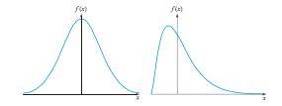
Plot of a skewed series versus a normal distribution

Slide 15
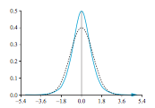
Plot of a leptokurtic series versus a normal distribution

Slide 16
Measures of association
Covariance is a linear measure of association between two series.
It is simple to calculate but scales with the standard deviations of the two series
The correlation is another measure of association that is calculated by dividing the covariance between two series by the product of their standard deviations
Correlations are unit-free and must lie between (-1,+1)
The correlation calculated in this way is more specifically known as Pearson’s correlation measure.
alternative measure: Spearman’s rank correlation measure – preferable when the data are a long way from following a normal distribution

Slide 17
Some algebra useful for working with means, variances and covariances
Means
The mean of a random variable y is also known as its expected value, written E(y).
The expected value of a constant is the constant, e.g. E(c) = c
The expected value of a constant multiplied by a random variable is equal to the constant multiplied by the expected value of the variable: E(cy)=c E(y). It can also be stated that E(cy+d)= cE(y)+d, where d is also a constant.
For two independent random variables, y₁ and y₂, E(y₁y₂) = E(y₁) E(y₂)

Slide 18
Some algebra useful for working with means, variances and covariances 2
Variances
The variance of a random variable y is usually written var(y).
The variance of a random variable y is given by var(y) = E[y − E(y)]². The variance of a constant is zero: var(c) = 0
For c and d constants, var(cy + d) = c²var(y)
For two independent random variables, y₁ and y₂, var(cy₁ + dy₂) = c²var(y₁) + d²var(y₂)
Covariances
The covariance between two random variables, y₁ and y₂ may be expressed as cov(y₁, y₂)
cov(y₁, y₂) = E[(y₁ − E(y₁))(y₂ − E(y₂))]
For two independent random variables, y₁ and y₂, cov(y₁, y₂) = 0
For four constants, c, d, e, and f, cov(c+dy₁, e+fy₂)=dfcov(y₁, y₂).

Slide 19
Data types

Slide 20
Types of Data and Notation
There are 3 types of data which econometricians might use for analysis:
1. Time series data
2. Cross-sectional data
3. Panel data, a combination of 1. & 2.
quantitative (exchange rates, stock prices, # of shares outstanding),
qualitative (day of the week)
Examples of time series data
Series Frequency
GNP or unemployment monthly, or quarterly
government budget deficit annually
money supply weekly
value of a stock market index as transactions occur

Slide 21
Time Series versus Cross-sectional Data
Problems that Could be Tackled Using a Time Series Regression:
- How the value of a country’s stock index has varied with that country’s
macroeconomic fundamentals.
- How the value of a company’s stock price has varied when it announced the
value of its dividend payment.
- The effect on a country’s currency of an increase in its interest rate
Cross-sectional data are data on one or more variables collected at a single point in time, e.g.
- A poll of usage of internet stock broking services
- Cross-section of stock returns on the New York Stock Exchange
- A sample of bond credit ratings for UK banks

Slide 22
Cross-sectional and Panel Data
Problems Tackled Using a Cross-Sectional Regression
- The relationship between company size and the return to investing in its shares
- The relationship between a country’s GDP level and the probability that the
government will default on its sovereign debt.
Panel Data has the dimensions of both time series and cross-sections, e.g. the daily prices of a number of blue chip stocks over two years.
Time series data: denote each observation by: t , total observations by T,
cross-sectional data: each observation: i and the total # by N

Slide 23
Continuous and Discrete Data
Continuous data can be any value and are not confined to take specific numbers.
Their values are limited only by precision.
For example, rental yield : 6.2%, 6.24%, or 6.238%.
Discrete data can only take on certain values, usually integers
Example: number of shares traded during a day.
They do not necessarily have to be integers (whole numbers) though, and are often defined to be count numbers.
For example, until recently when they became ‘decimalised’, many financial asset prices were quoted to the nearest 1/16 or 1/32 of a dollar.

Slide 24
Cardinal, Ordinal and Nominal Numbers
Another way to classify numbers : cardinal, ordinal, or nominal.
Cardinal numbers - actual numerical values that a particular variable takes have meaning, and where there is an equal distance between the numerical values.
Examples - price of a share or of a building, and the number of houses in a street.
Ordinal numbers can only be interpreted as providing a position or an ordering.
Thus, for cardinal numbers, a figure of 12 implies a measure that is `twice as good' as a figure of 6. On the other hand, for an ordinal scale, a figure of 12 may be viewed as `better' than a figure of 6, but could not be considered twice as good. Examples of ordinal numbers would be the position of a runner in a race.

Slide 25
Cardinal, Ordinal and Nominal Numbers (Cont’d)
Nominal numbers occur where there is no natural ordering of the values at all.
Such data often arise when numerical values are arbitrarily assigned, such as telephone numbers or when codings are assigned to qualitative data (e.g. when describing the exchange that a US stock is traded on.
Cardinal, ordinal and nominal variables may require different modelling approaches or at least different treatments, as should become evident in the subsequent chapters.

Slide 26
Arithmetic and geometric series, present and future values

Slide 27
Arithmetic and geometric series
An arithmetic progression is a sequence where a specific entry in that series is formed by adding a fixed number, known as the common difference, to the previous one. For example: 2,5,8,11,... or −10,−30,−50,...
The first of these is an arithmetic series with an initial value of 2 and adds 3 each time we move from one entry in the sequence to the next; the second set is an arithmetic series with an initial value of −10 and a common difference of −20.
A geometric progression is a series where instead of adding a fixed amount to move from one entry to the next, we multiply by a fixed amount (the common ratio). For example: 4,8,16,32,... or 2,1,0.5,0.25,...
The first of these is a geometric series with an initial value of 4 and a common ratio of 2, while the second set is a geometric series with an initial value of 2 and a common ratio of 0.5.
Geometric series are very useful in finance as they describe the situation where a sum of money is invested and earns a certain percentage of interest in each time period.

Slide 28

Sums of geometric series
To develop some notation, let a denote the initial value of a geometric series (starting with the term numbered 0 and ending with term numbered n − 1), and let d denote the common ratio.
We could write a geometric series containing n terms as
a, ad, ad², ad³, ..., ad^{n−1}
There is an expression that can be used to calculate the sum of the first n terms, denoted S_{n}, of the series (running from a to ad^{n−1})
For instance, if a geometric series begins with 2 and has a common ratio of 3, the sum of the first 8 terms would be
S_{n} = 2×(1−3⁸) / (1−3) = 6560

Slide 29
Sums of infinite geometric series
Of particular use in financial applications is the infinite sum of a geometric progression, denoted S∞
We can see what will happen to the sum of n terms as n tends to infinity, since the term d^{n} will tend towards zero (so long as 0 < d < 1), in which case the expression can be simplified as:
Here, even though there is an infinite number of terms in the series, their sum is finite
Note that if d ≥ 1, the series would not ‘converge’ (i.e., successive terms would not become smaller and smaller) and therefore the sum would be infinite.

Slide 30
Present values and future values
Money has time value. This means that receipt of a given amount of money is worth a different amount depending on when it is received. In general, money has positive time value
As a result of the time value of money, we cannot simply combine cashflows in their raw form into financial calculations if they are received at different points in time
The way that we ensure we are comparing like-with-like is to transform the cashflows to what they would be worth if they were all received at the same point in time
(the future value) transform all cashflows to the amount that they would be worth at some given point in the future
(the present value) or we transform all future cashflows into the equivalent amount that they would be worth if received today

Slide 31
Future values
Suppose that we place $100 in a bank savings account for five years, paying an annual interest rate of 2%. The sum of money in the account at the end of the period would be given by
P_{T} = P₀ ×(1+r)^{T}
where P_{T} denotes the terminal (future) value of the account, r is the interest rate, P₀ is the amount placed in the account now, and T is the number of time periods for which the money is invested
End of first year: P_{T} =$100×(1+0.02)=$102,
End of second year: P_{T} = $100 × (1 + 0.02)²
= $102 × (1 + 0.02) = $104.04
fifth year, P_{T} = £100 × (1 + 0.02)⁵ = £110.41
In this case the interest is compounded annually – interest is paid this year on the total value of this year’s end savings, which will comprise both last year’s savings value and last year’s interest.

Slide 32
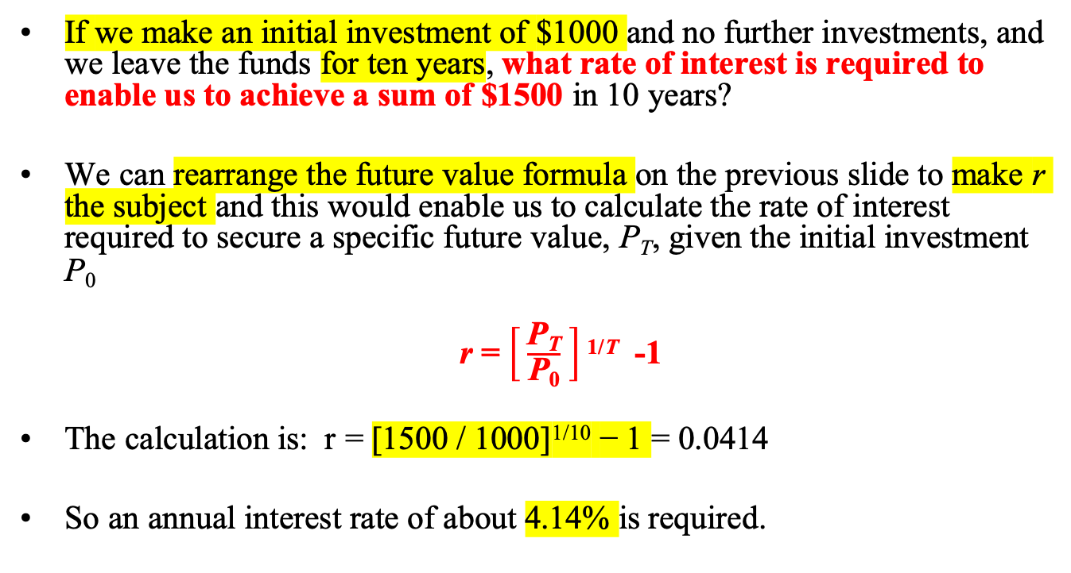
Future values – calculating the interest rate
If we make an initial investment of $1000 and no further investments, and we leave the funds for ten years, what rate of interest is required to enable us to achieve a sum of $1500 in 10 years?
We can rearrange the future value formula on the previous slide to make r the subject and this would enable us to calculate the rate of interest required to secure a specific future value, P_{T}, given the initial investment P₀
r = $\left[ \frac{\text{P}\text{T}}{\text{P}\text{0}} \right]$^{1/T} -1
The calculation is: r = [1500 / 1000]^{1/10} − 1 = 0.0414
So an annual interest rate of about 4.14% is required.

Slide 33

Future values – calculating the time to achieve a certain sum
A further rearrangement of the equations on the previous slides enables us to make the term of the investment, T, the subject of the formula
If we invest $1000, wish it to grow to $2000, interest 10%, how many years?
T = ln(2000/1000) / ln(1+0.1) = 7.273
Notice that we can use the formula above to determine how many years it would take for an investment to grow by a factor of Z
where P_{T} =ZP₀
So, for example, if we wanted to triple the initial investment with r = 10%, we would set Z = 3 :
T = ln(3) / ln (1+0.1) = 11.527 years.

Slide 34
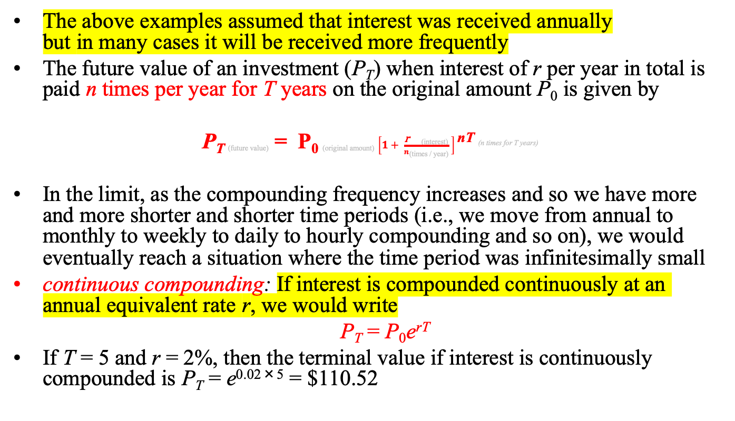
Compounding frequency
The above examples assumed that interest was received annually but in many cases it will be received more frequently
The future value of an investment (P_{T}) when interest of r per year in total is paid n times per year for T years on the original amount P₀ is given by
P_{T (future value)} = P_{0 (original amount)} $\left[1+ \frac{\text{r} \text{(}\text{interest}\text{)}}{n\text{(}\text{times}\text{ / }\text{year}\text{)}} \right]$^{nT (n times for T years)}
In the limit, as the compounding frequency increases and so we have more and more shorter and shorter time periods (i.e., we move from annual to monthly to weekly to daily to hourly compounding and so on), we would eventually reach a situation where the time period was infinitesimally small
continuous compounding: If interest is compounded continuously at an annual equivalent rate r, we would write
P_{T} = P₀e^{rT}
If T = 5 and r = 2%, then the terminal value if interest is continuously compounded is P_{T} = e^{0.02×5} = $110.52

Slide 35
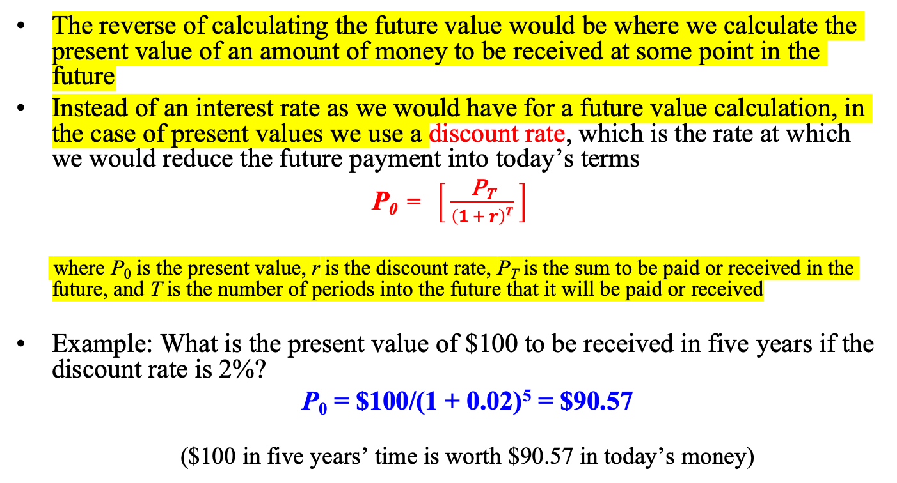
Present value
The reverse of calculating the future value would be where we calculate the present value of an amount of money to be received at some point in the future
Instead of an interest rate as we would have for a future value calculation, in the case of present values we use a discount rate, which is the rate at which we would reduce the future payment into today’s terms
P₀ = $\left[ \frac{\text{P}\text{T}}{\left(1 + r\right)T} \right]$
where P₀ is the present value, r is the discount rate, P_{T} is the sum to be paid or received in the future, and T is the number of periods into the future that it will be paid or received
Example: What is the present value of $100 to be received in five years if the discount rate is 2%?
P₀ = $100/(1 + 0.02)⁵ = $90.57
($100 in five years’ time is worth $90.57 in today’s money)

Slide 36

Present value calculations for pricing bonds
A bond pays a $10 coupon annually with the next coupon due immediately. The bond has exactly five years left to maturity when it will be redeemed at its par value of $100 and an appropriate discount rate is 10%. What would be a fair price to pay today for the bond?
We would calculate the fair price as the discounted sum of the six coupon payments (one now and one at the end of each of the next five years) and plus the discounted value of the par amount of the bond. If we let the fair price in pounds be denoted by P₀, the calculation would be:
The fair price to pay for the bond is P₀ = $86.04

Slide 37

Present value calculations for pricing irredeemable bonds
If the bond was irredeemable (it had an infinite lifetime like a stock), we would need to use the S∞ formula to calculate its present value.
what should an investor pay today for a perpetual (irredeemable) bond that pays a coupon of $5 every six months if the appropriate rate to discount future cashflows is 4% per annum and the next coupon will be paid immediately?
We could discount each cashflow with the discount rate for six months, which would be 2%. We could write this as an infinite series beginning with $5:
We need to be slightly careful as the common difference here is
1/(1 + 0.02). Then we would have the value as
S∞ = $5 / (1 − [1/(1 + 0.02)]) = $255

Slide 38

Internal rate of return
Sometimes we know the present value, and the future cashflows, but we do not know the discount rate.
Internal rate of return or IRR: The value of r that would equate the amount to be paid today P₀ to the present value of all of the cashflows we would receive if we purchased the asset
We could calculate that by solving the annuity formula above for r. More generally, if the future cashflow payments were not fixed but varied over time, we would have a more flexible formula
If there are only one or two time-periods, we could solve the equation by hand; for more we would need to use a spreadsheet.

Slide 39
Returns in Financial Modelling
It is preferable not to work directly with asset prices, so we usually convert the raw prices into a series of returns. There are two ways to do this:
Simple returns or log returns
where, R_{t} denotes the return at time t
p_{t} denotes the asset price at time t
ln denotes the natural logarithm
We also ignore any dividend payments, or alternatively assume that the price series have been already adjusted to account for them.

Slide 40
Log Returns
The returns are also known as log price relatives, which will be used throughout this book. There are a number of reasons for this:
1. They have the nice property that they can be interpreted as continuously
compounded returns.
2. Can add them up, e.g. if we want a weekly return and we have calculated
daily log returns:
r₁ = ln p₁/p₀ = ln p₁ - ln p₀
r₂ = ln p₂/p₁ = ln p₂ - ln p₁
r₃ = ln p₃/p₂ = ln p₃ - ln p₂
r₄ = ln p₄/p₃ = ln p₄ - ln p₃
r₅ = ln p₅/p₄ = ln p₅ - ln p₄
⎯⎯⎯⎯⎯
ln p₅ - ln p₀ = ln p₅/p₀

Slide 41
A Disadvantage of using Log Returns
There is a disadvantage of using the log-returns. The simple return on a portfolio of assets is a weighted average of the simple returns on the individual assets:
But this does not work for the continuously compounded returns.

Slide 42
Real Versus Nominal Series
The general level of prices has a tendency to rise most of the time because of inflation
We may wish to transform nominal series into real ones to adjust them for inflation
This is called deflating a series or displaying a series at constant prices
We do this by taking the nominal series and dividing it by a price deflator:
real series_{t} = nominal series_{t} × 100 / deflator_{t}
(assuming that the base figure is 100)
We only deflate series that are in nominal price terms, not quantity terms.

Slide 43
Deflating a Series
If we wanted to convert a series into a particular year’s figures (e.g. house prices in 2010 figures), we would use:
real series_{t} = nominal series_{t} × deflator_{reference year} / deflator_{t}
This is the same equation as the previous slide except with the deflator for the reference year replacing the assumed deflator base figure of 100
Often the consumer price index, CPI, is used as the deflator series.

Slide 44
Portfolio theory using matrix algebra

Slide 45

Portfolio Theory and Matrix Algebra - Basics
Probably the most important application of matrix algebra in finance is to solving portfolio allocation problems
Suppose that we have a set of N stocks that are included in a portfolio P with weights w₁,w₂, . . . ,w_{N} and suppose that their expected returns are written as E(r₁),E(r₂), . . . ,E(r_{N}). We could write the N × 1 vectors of weights, w, and of expected returns, E(r), as
The expected return on the portfolio, E(r_{P} ) can be calculated as E(r)′w.

Slide 46
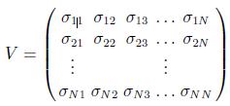
The Variance-Covariance Matrix
The variance-covariance matrix of the returns, denoted V includes all of the variances of the components of the portfolio returns on the leading diagonal and the covariances between them as the off-diagonal elements.
The variance-covariance matrix of the returns may be written
For example:
σ₁₁ is the variance of the returns on stock one, σ₂₂ is the variance of returns on stock two, etc.
σ₁₂ is the covariance between the returns on stock one and those on stock two, etc.

Slide 47
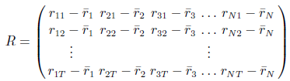
Constructing the Variance-Covariance Matrix
In order to construct a variance-covariance matrix we would need to first set up a matrix containing observations on the actual returns , R (not the expected returns) for each stock where the mean, r_{i} (i = 1, . . . ,N), has been subtracted away from each series i.
We would write
The general entry, r_{ij} , is the j^{th} time-series observation on the i^{th} stock. The variance-covariance matrix would then simply be calculated as V = (R′R)/(T − 1)

Slide 48
The Variance of Portfolio Returns
Suppose that we wanted to calculate the variance of returns on the portfolio P
A scalar which we might call V_{P}
We would do this by calculating V_{P} = w′V w
Checking the dimension of V_{P} , w′ is (1 × N), V is (N × N) and w is (N × 1) so V_{P} is (1 × N × N × N × N × 1), which is (1 × 1) as required

Slide 49
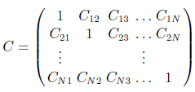
The Correlation between Returns Series
We could define a correlation matrix of returns, C, which would be
This matrix would have ones on the leading diagonal and the off-diagonal elements would give the correlations between each pair of returns
Note that the correlation matrix will always be symmetrical about the leading diagonal
Using the correlation matrix, the portfolio variance is V_{P} = w′SCSw
where S is a diagonal matrix containing the standard deviations of the portfolio returns.

Slide 50


Selecting Weights for the Minimum Variance Portfolio
Although in theory the optimal portfolio on the efficient frontier is better, a variance-minimising portfolio often performs well out-of-sample
The portfolio weights w that minimise the portfolio variance, V_{P} is written
We also need to be slightly careful to impose at least the restriction that all of the wealth has to be invested (weights sum to one)
This restriction is written as w′· 1_{N} = 1, where 1_{N} is a column vector of ones of length N.
The minimisation problem can be solved to
where MV P stands for minimum variance portfolio

Slide 51
Selecting Optimal Portfolio Weights
In order to trace out the mean-variance efficient frontier, we would repeatedly solve this minimisation problem but in each case set the portfolio’s expected return equal to a different target value,
We would write this as
This is sometimes called the Markowitz portfolio allocation problem
It can be solved analytically so we can derive an exact solution
But it is often the case that we want to place additional constraints on the optimisation, e.g.
Restrict the weights so that none are greater than 10% of overall wealth
Restrict them to all be positive (i.e. long positions only with no short selling)
In such cases the Markowitz portfolio allocation problem cannot be solved analytically and thus a numerical procedure must be used

Slide 52


Selecting Optimal Portfolio Weights
If the procedure above is followed repeatedly for different return targets, it will trace out the efficient frontier
In order to find the tangency point where the efficient frontier touches the capital market line, we need to solve the following problem
If no additional constraints are required on weights, this can be solved as
Note that it is also possible to write the Markowitz problem where we select the portfolio weights that maximise the expected portfolio return subject to a target maximum variance level.

Slide 53
Bayesian versus Classical Statistics
The philosophical approach to model-building used here throughout is based on ‘classical statistics’
This involves postulating a theory and then setting up a model and collecting data to test that theory
Based on the results from the model, the theory is supported or refuted
There is, however, an entirely different approach known as Bayesian statistics
Here, the theory and model are developed together
The researcher starts with an assessment of existing knowledge or beliefs formulated as probabilities, known as priors
The priors are combined with the data into a model

Slide 54
Bayesian versus Classical Statistics (Cont’d)
The beliefs are then updated after estimating the model to form a set of posterior probabilities
Bayesian statistics is a well established and popular approach, although less so than the classical one
Some classical researchers are uncomfortable with the Bayesian use of prior probabilities based on judgement
If the priors are very strong, a great deal of evidence from the data would be required to overturn them
So the researcher would end up with the conclusions that he/she wanted in the first place!
In the classical case by contrast, judgement is not supposed to enter the process and thus it is argued to be more objective.

